Slide 1
PHP for Server-Side Programming
By Jinzhu Gao

Slide 2
Objectives
Create pages that takes advantage of data and resources on a web server and present it to the user in dynamic ways

Slide 3
Motivation
HTML cannot express similarity in a compact way
Large amounts of redundant content in a page
Redundancy between pages
Needs to create dynamic web pages

Slide 4
Web Pages
Static content/fixed content
A client’s browser requests a simple .html file
The web server software (Apache/IIS) reads the file from the disk and sends its contents back to the client
Dynamic content
Web pages generated on-the-fly by a web server at the moment a user requests them.

Slide 5
URLs and Web Servers
When you type a URL in your browser:
http://training.pacificescience.com
Your computer looks up the server's IP address using DNS
Your browser connects to that IP address and requests the given file
The web server software (e.g. Apache) grabs that file from the server's local file system, and sends back its contents to you

Slide 6
URLs and Web Servers
Some URLs actually specify programs that the web server should run, and then send their output back to you as the result:
http://www.pacificescience.com/jgao/contact.php
the above URL tells the server www.pacificescience.com to run the program contact.php and send back its output

Slide 7

Server-Side Web Programming
Server-side scripting
Writing programs to generate dynamic content
Server-side pages are programs written using one of web programming languages/frameworks such as
PHP, Java/JSP, Ruby on Rails, ASP.NET, Python, Perl
The web server contains software to run those programs and send the output back to the client

Slide 8
PHP
“PHP Hypertext Preprocessor”
A server-side scripting language
Used to make web pages dynamic:
provide different content depending on context
interface with other services: database, e-mail, etc
authenticate users
process form information
PHP code can be embedded in HTML code

Slide 9
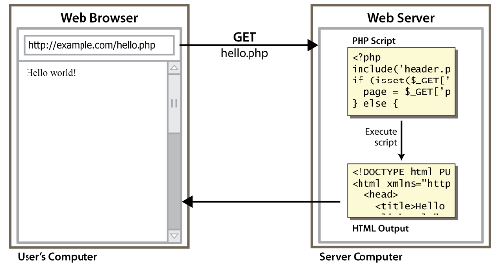
Lifecycle of a PHP Web Request

Slide 10
Lifecycle of a PHP Web Request
Browser requests a .html file (static content):
server just sends that file
Browser requests a .php file (dynamic content):
server reads it, runs any script code inside it, then sends result across the network
script produces output that becomes the response sent back

Slide 11
Advantages of PHP
free and open source
compatible:
supported by most popular web servers
simple:
lots of built-in functionality; familiar syntax
widely available
well-documented:
type php.net/functionName in browser Address bar to get docs for any function

Slide 12
PHP vs. other language
PHP source code is translated and executed dynamically/interpreted by the web server
PHP has more relaxed syntax than Java and C
The key construct in PHP is the function rather than the class
Most PHP code is contained within a web page and integrated with that page’s HTML content

Slide 13
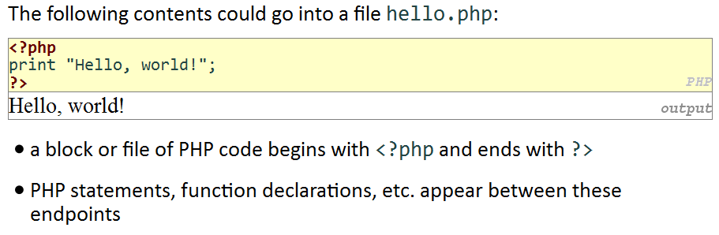
First PHP Program: hello.php

Slide 14
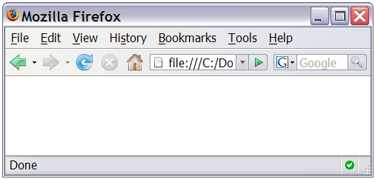
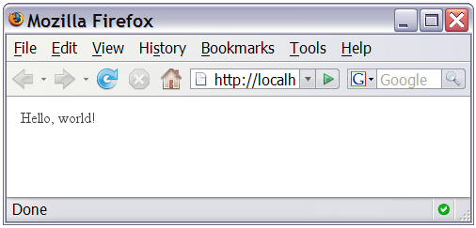
PHP Output
You can't view your .php page on your local hard drive; you'll either see nothing or see the PHP source code
If you upload the file to a PHP-enabled web server, requesting the .php file will run the program and send you back its output

Slide 15
PHP Syntax
<?php
Statements;
?>
HTML content
<?php
Statements;
?>
HTML content

Slide 16
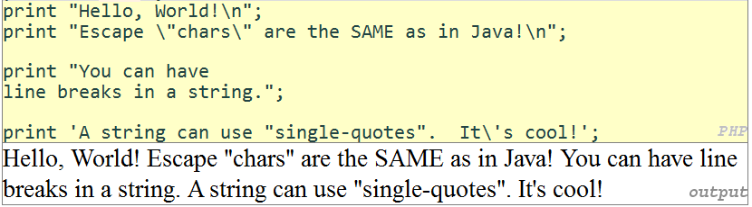
The print Statement
print “text”;
Notes:
The output of PHP code is directly inserted into the HTML text and the browser largely ignores whitespace
some PHP programmers use the equivalent echo instead of print

Slide 17
Types
int, float, boolean, string, array, object, NULL
is_string (…) : tests what type a variable is
gettype(…) : returns a variable’s type as a string
PHP converts between types automatically in many cases:
string → int auto-conversion on + ("1" + 1 == 2)
int → float auto-conversion on / (3 / 2 == 1.5)
type-cast with (type):
$age = (int) "21";

Slide 18
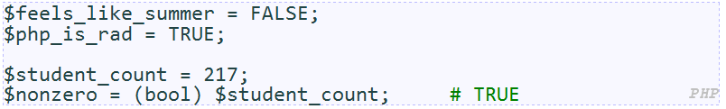
Boolean/bool type
The following values are considered to be FALSE (all others are TRUE):
0 and 0.0
"", "0", and NULL (includes unset variables)
arrays with 0 elements
Can cast to boolean using (bool)
FALSE prints as an empty string (no output); TRUE prints as a 1

Slide 19
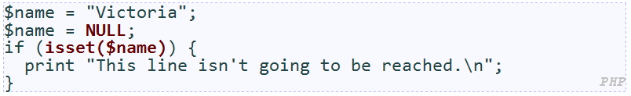
NULL
a variable is NULL if
it has not been set to any value (undefined variables)
it has been assigned the constant NULL
it has been deleted using the unset function
can test if a variable is NULL using the isset function
NULL prints as an empty string (no output)

Slide 20

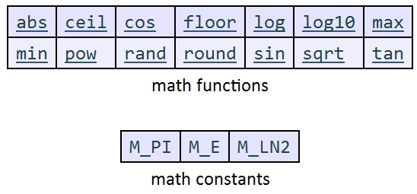
Arithmetic
Arithmetic operators:
+, -, *, /, %

Slide 21

Variables
$name = expression;

Slide 22
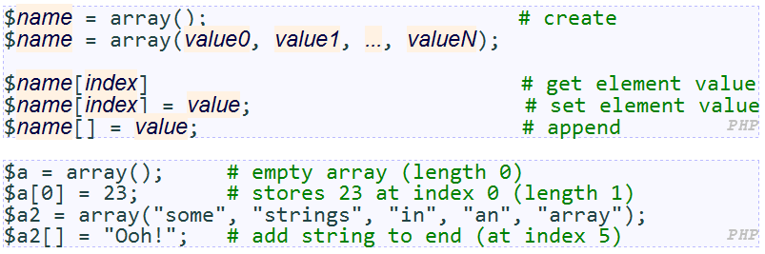
Arrays
to append, use bracket notation without specifying an index
element type is not specified; can mix types

Slide 23
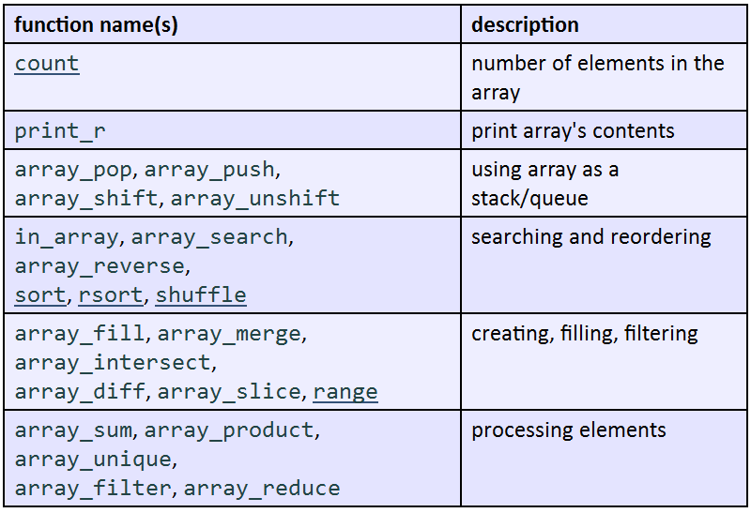
Array Functions

Slide 24
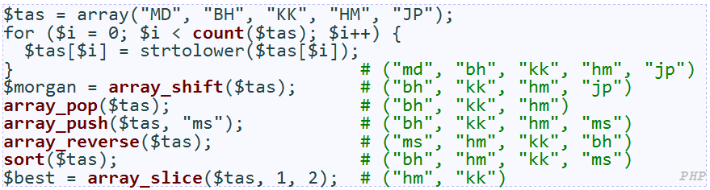
Array Functions

Slide 25
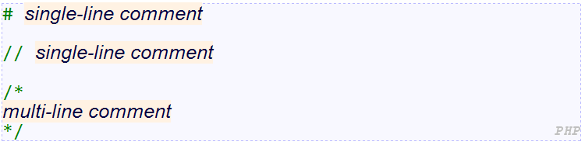
Comments

Slide 26
Strings
zero-based indexing using bracket notation
string concatenation operator is . (period), not +
5 + "2 turtle doves" === 7
5 . "2 turtle doves" === "52 turtle doves"
can be specified with "" or ''

Slide 27
Interpreted Strings
strings inside " " are interpreted
variables that appear inside them will have their values inserted into the string
strings inside ' ' are not interpreted:

Slide 28
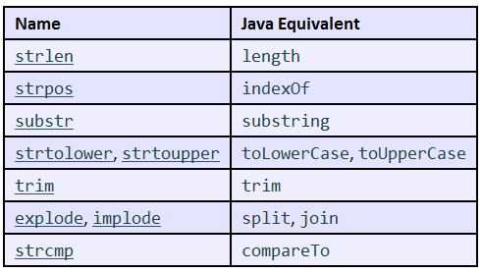
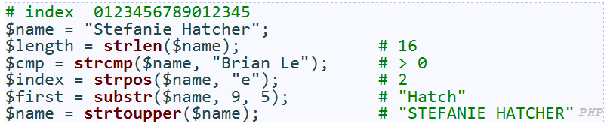
string functions

Slide 29
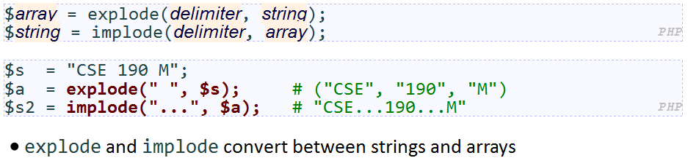
string functions

Slide 30
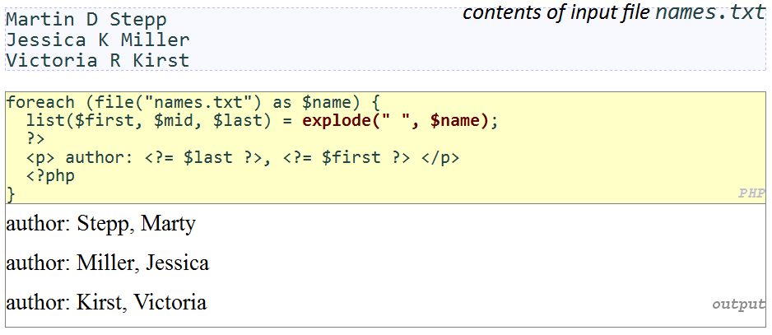
string functions

Slide 31
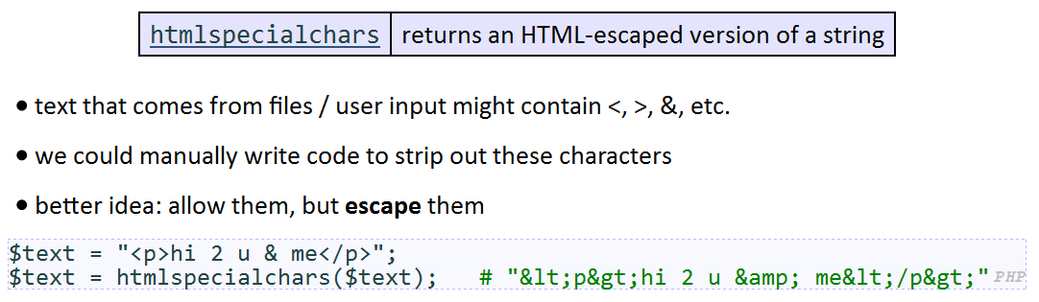
htmlspecialchars function

Slide 32
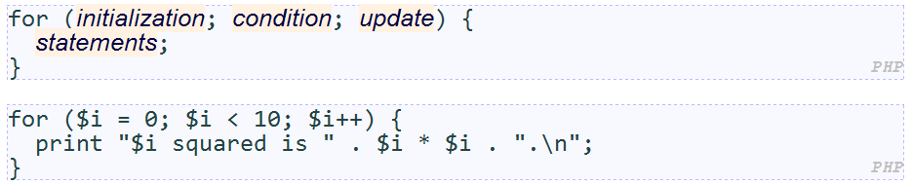
Control Statements
for loop

Slide 33
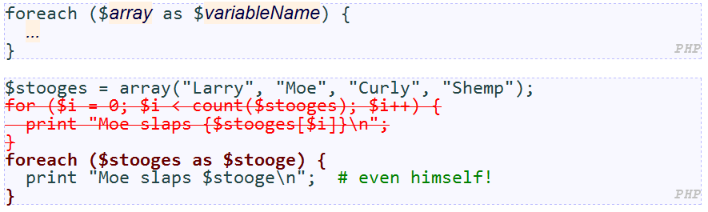
Control Statements
foreach loop

Slide 34
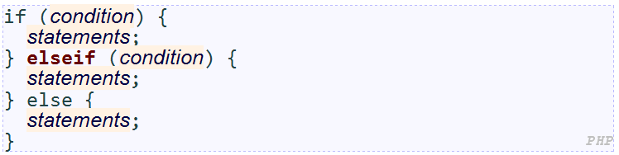
Control Statements
if/else loop

Slide 35
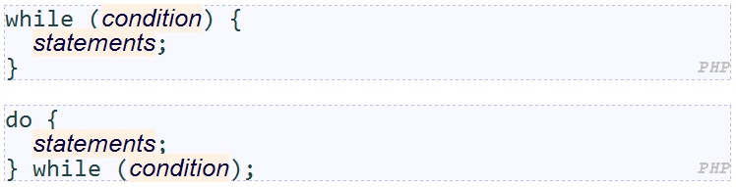
Control Statements
while loop
break and continue keywords also behave as in Java/C

Slide 36
Self-Check
Page 169

Slide 37
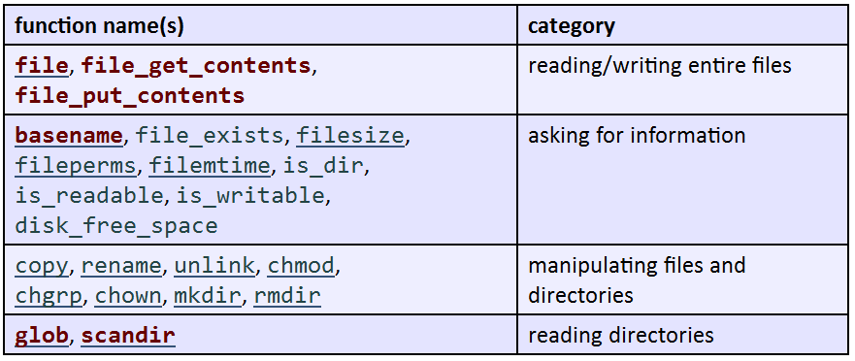
Advanced PHP Syntax
PHP file I/O functions

Slide 38
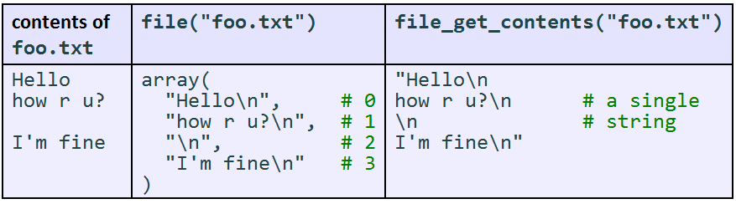
Advanced PHP Syntax
Reading/writing files
file returns lines of a file as an array (\n at end of each)
file_get_contents returns entire contents of a file as a single string
file_put_contents writes a string into a file
Notes:
Strrev: reverses the order of the characters in the given string

Slide 39
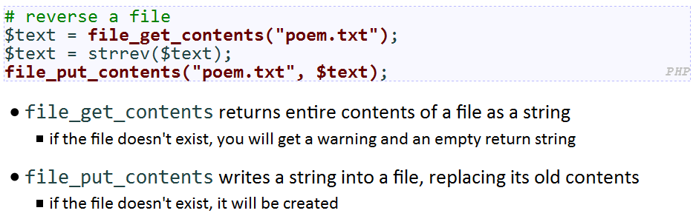
Advanced PHP Syntax
Reading/writing files
file returns lines of a file as an array (\n at end of each)
file_get_contents returns entire contents of a file as a single string
file_put_contents writes a string into a file
Notes:
Strrev: reverses the order of the characters in the given string

Slide 40
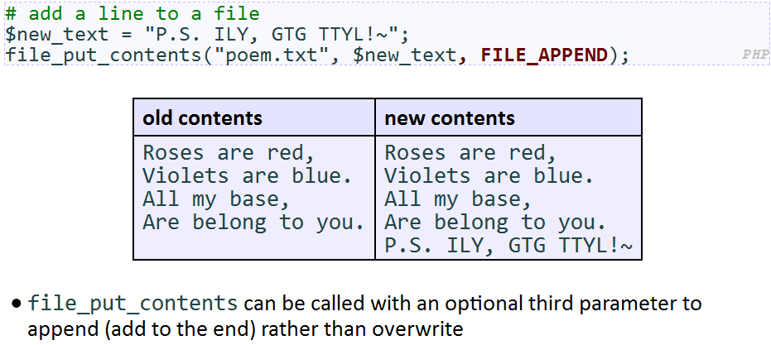
Advanced PHP Syntax
Reading/writing files
file returns lines of a file as an array (\n at end of each)
file_get_contents returns entire contents of a file as a single string
file_put_contents writes a string into a file
Notes:
Strrev: reverses the order of the characters in the given string

Slide 41
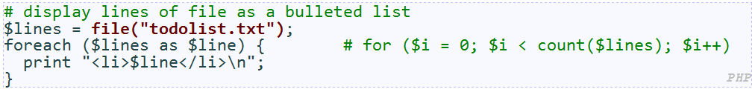
Advanced PHP Syntax
file function:
Returns the lines of a file as an array of strings
each ends with \n ; to strip it, use an optional second parameter:
$lines = file("todolist.txt", FILE_IGNORE_NEW_LINES);
common idiom: foreach or for loop over lines of file

Slide 42
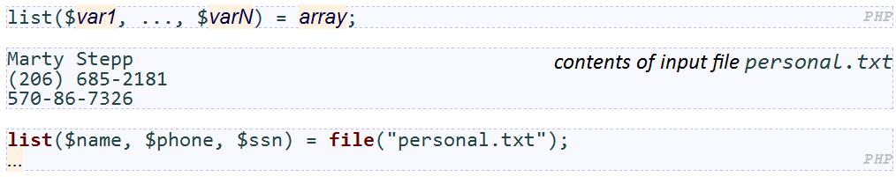
Advanced PHP Syntax
list function

Slide 43
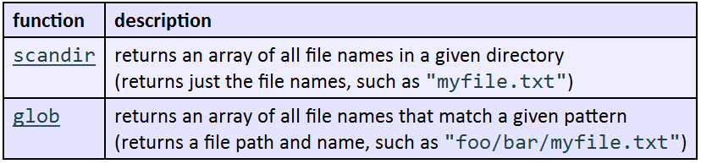
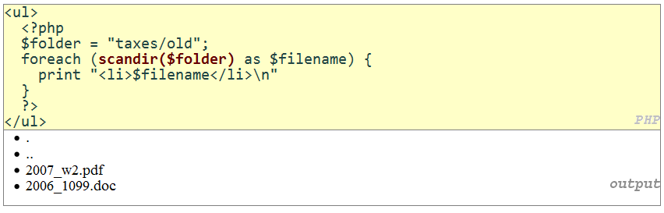
Advanced PHP Syntax
Reading directories
Notes:
glob can match a "wildcard" path with the * character
glob("foo/bar/*.doc") returns all .doc files in the foo/bar subdirectory
glob("food*") returns all files whose names begin with "food"
the basename function strips any leading directory from a file path
basename("foo/bar/baz.txt") returns "baz.txt"

Slide 44
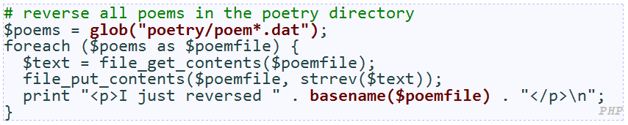
Advanced PHP Syntax
Reading directories
Notes:
glob can match a "wildcard" path with the * character
glob("foo/bar/*.doc") returns all .doc files in the foo/bar subdirectory
glob("food*") returns all files whose names begin with "food"
the basename function strips any leading directory from a file path
basename("foo/bar/baz.txt") returns "baz.txt"

Slide 45
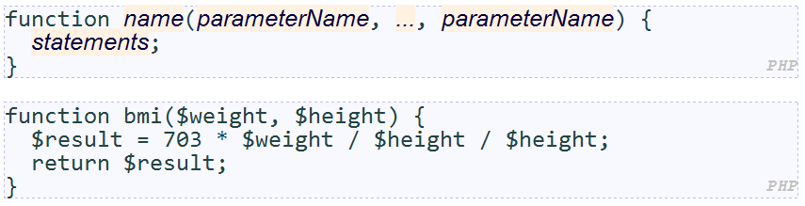

Advanced PHP Syntax
Functions
parameter types and return types are not written
a function with no return statements is implicitly "void"
can be declared in any PHP block, at start/end/middle of code

Slide 46
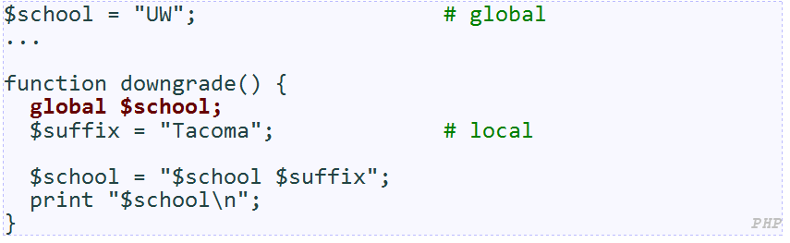
Advanced PHP Syntax
Functions:
variables declared in a function are local to that function; others are global

Slide 47
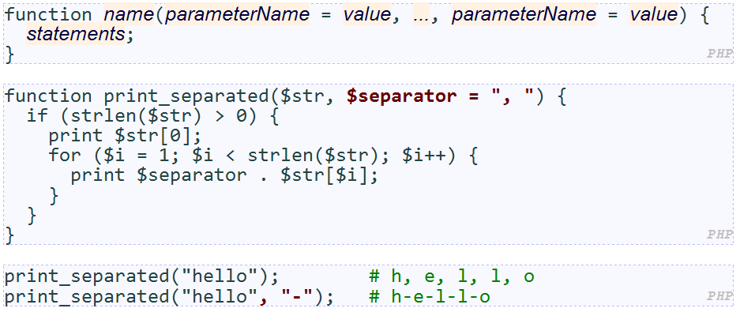
Advanced PHP Syntax
Functions:
if no value is passed, the default will be used (defaults must come last)

Slide 48
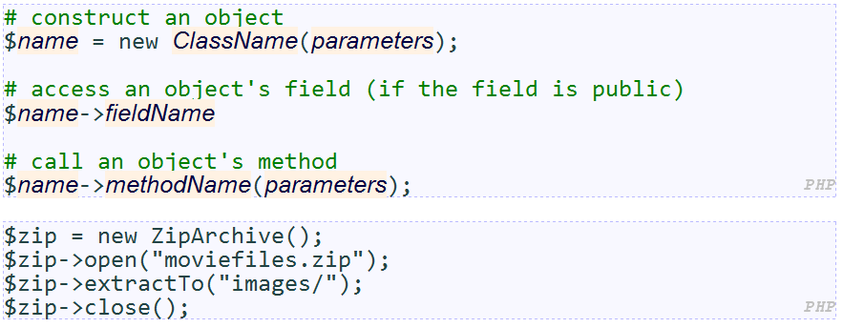
Advanced PHP Syntax
Constructing and using objects
Test whether a class is installed with class_exists
The following code unzips a file

Slide 49
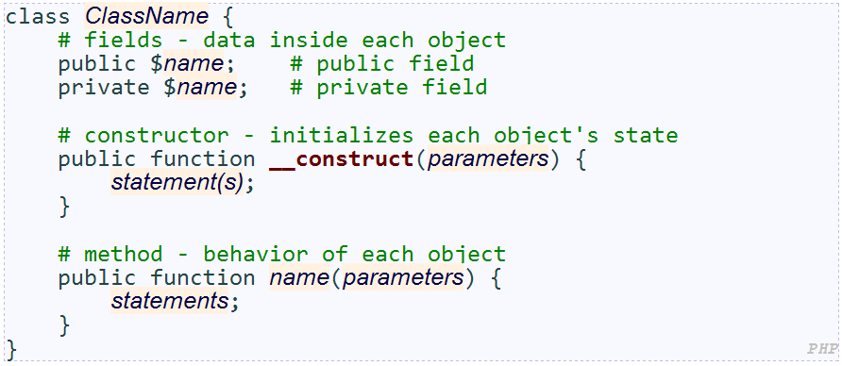
Advanced PHP Syntax
Classes:

Slide 50
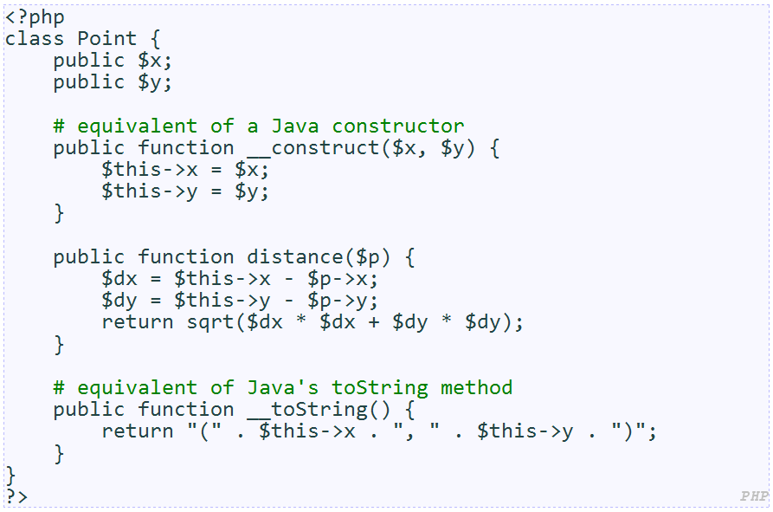
Advanced PHP Syntax
Classes:

Slide 51
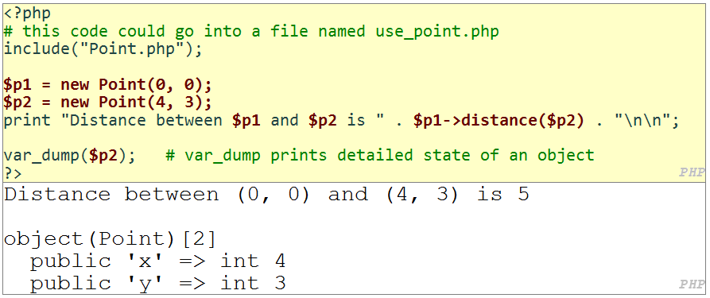
Advanced PHP Syntax
Classes:

Slide 52
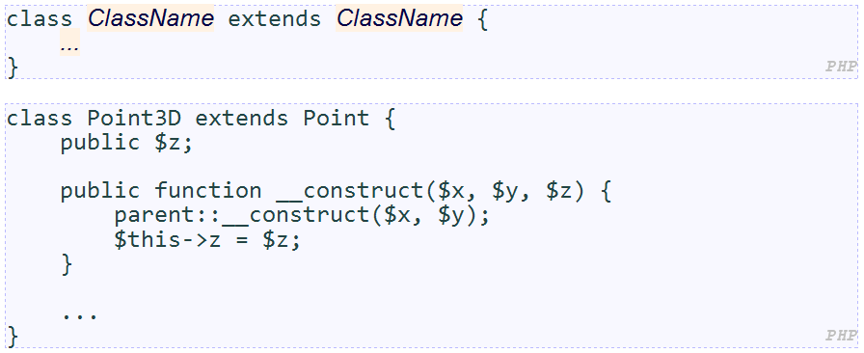
Advanced PHP Syntax
Classes: Basic inheritance

Slide 53
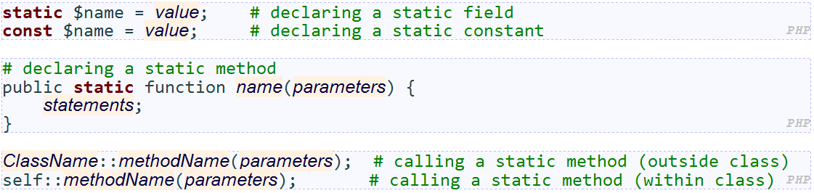
Advanced PHP Syntax
Static methods, fields, and constants

Slide 54
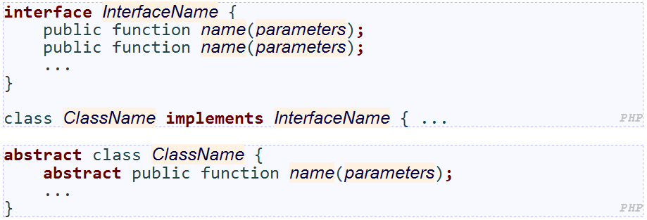
Advanced PHP Syntax
Abstract classes and interfaces
interfaces are supertypes that specify method headers without implementations
abstract classes are like interfaces, but you can specify fields, constructors, methods

Slide 55
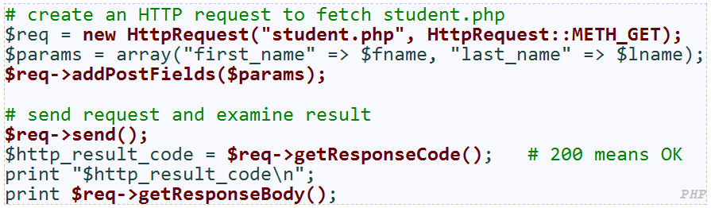
Advanced PHP Syntax
PHP's HttpRequest object can fetch a document from the web

Slide 56
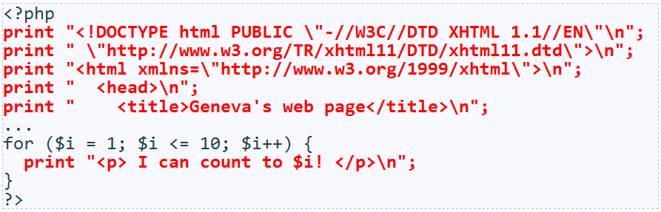
Embedded PHP
Insert PHP code into HTML seamlessly to produce a dynamic results
Design goal
Maximize the amount of the code that is spent in plain HTML “mode”
Minimize the amount spent in PHP “mode”
Printing HTML tags with print statements is bad style and error-prone:

Slide 57
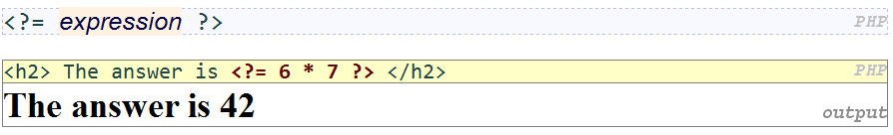
PHP Expression Blocks
evaluates and embeds an expression's value into HTML
<?= expr ?> is equivalent to <?php print expr; ?>
<? expr ?> is equivalent to <?php expr ?>

Slide 58
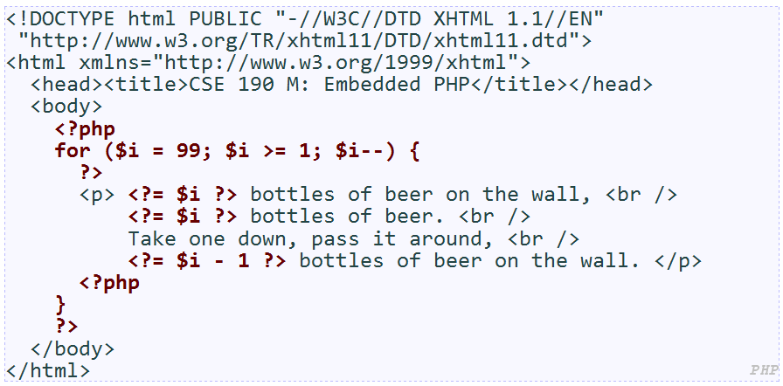
PHP Expression Blocks
evaluates and embeds an expression's value into HTML
<?= expr ?> is equivalent to <?php print expr; ?>
<? expr ?> is equivalent to <?php expr ?>

Slide 59
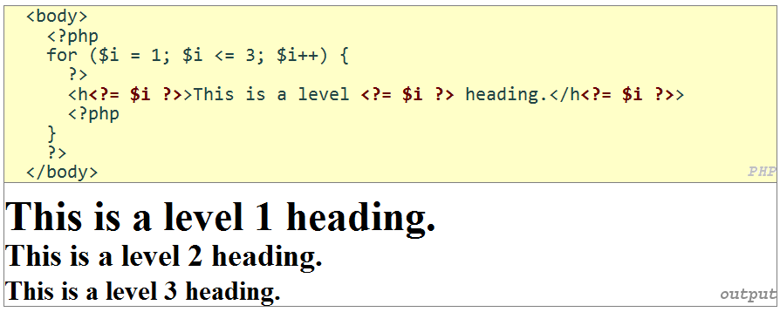
PHP Expression Blocks
evaluates and embeds an expression's value into HTML
<?= expr ?> is equivalent to <?php print expr; ?>
<? expr ?> is equivalent to <?php expr ?>

Slide 60
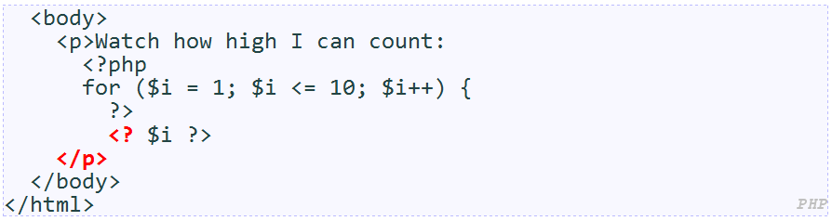
PHP Expression Blocks: Common Errors
Notes:
Missing = page 161

Slide 61
Self-Check
Page 193
Reading Assignment:
Ch 5.5 Case Study: Word of the Day
http://www.pacificescience.com/jgao/COMP127/code/ch05-php/index.php

Slide 62
Summary
PHP Syntax
Print, Types, Arithmetic, Variables, Strings, Comments, Boolean, Control statements
Functions, Including files, Arrays, foreach, File I/O
Embedded PHP
Expression blocks

